Slide 1
Image Processing REVIEW 2
Fruit Recognition using Dominant Colour Realisation and Feature Extraction
By
Anshuman Saboo
17BCE0141

Slide 2
Problems addressed
With the age of technology, image restoration and creation has become a very pivotal part of many industry.
A problem many Statistician and data scientist face are of better images in data models. Many real images do not fit the content of what we perform.
With so many factors we do have lost of issue in preprocessing. Colour grading is the key here
With these problems, many cannot implement in machine learning algorithms to perform well

Slide 3
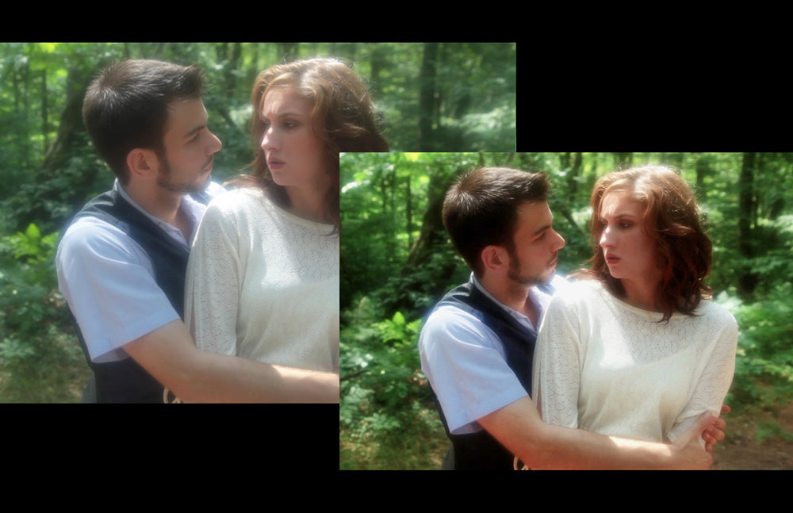
limitation of the existing work
Many companies have not implemented k-means clustering, most take assumed pictures.
In the Heart of the Sea is a movie where bad grading caused very bad visuals throughout the movies.

Slide 4
So what do we propose
k-means Clustering: k-means clustering is a method of vector quantization, originally from signal processing, that is popular for cluster analysisin data mining.
Canny Edge Detection: The Canny edge detector is an edge detection operator that uses a multistage algorithm to detect a wide range of edges in images. It was developed by John F. Canny in 1986. Canny also produced a computational theory of edge detection explaining why the technique works

Slide 5
Methodology
We Will make functions for the following
Most Dominant Color Finder: Function to find the most dominant color or the blend of most dominant color out for the image. Uses k-mean clustering
Enclosed Area Finder: This whole function is to join the edges of the image so that it can the find the inside pixels to replace with dominant color here this function

Slide 6

Implementation
Why Jupyter notebook?

Slide 7
Conclsusion
Final Functions:
First import the image
Then find the canny edge
Convert the image form binary form to rgb format
Then finds the fill area
Find the most dominant color for the image
After finding the most dominant color
It merges/overlays all the image following the priority
Top layer the canny edge
Second layer the fill area with the most dominant color
The bottom layer being the original image

Slide 8
rEFERENCES
Su, Mu-Chun, and Chien-Hsing Chou. "A modified version of the K-means algorithm with a distance based on cluster symmetry." IEEE Transactions on Pattern Analysis & Machine Intelligence 6 (2001): 674-680.
Van der Walt, Stefan, et al. "scikit-image: image processing in Python." PeerJ 2 (2014): e453.
Poorani, S., and P. Gokila Brindha. "Automatic detection of pomegranate fruits using K-mean clustering." Int. J. Adv. Res. Sci. Eng 3.8 (2014): 198-202.

Slide 9
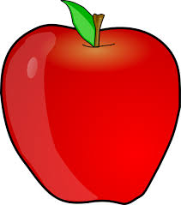
fUTURE-Review 3
We will implement the functions and generate the most dominant colour image.
We will use that picture in the machine learning algorithm to see how much percentage similar the processed image is.
Example :

Slide 10
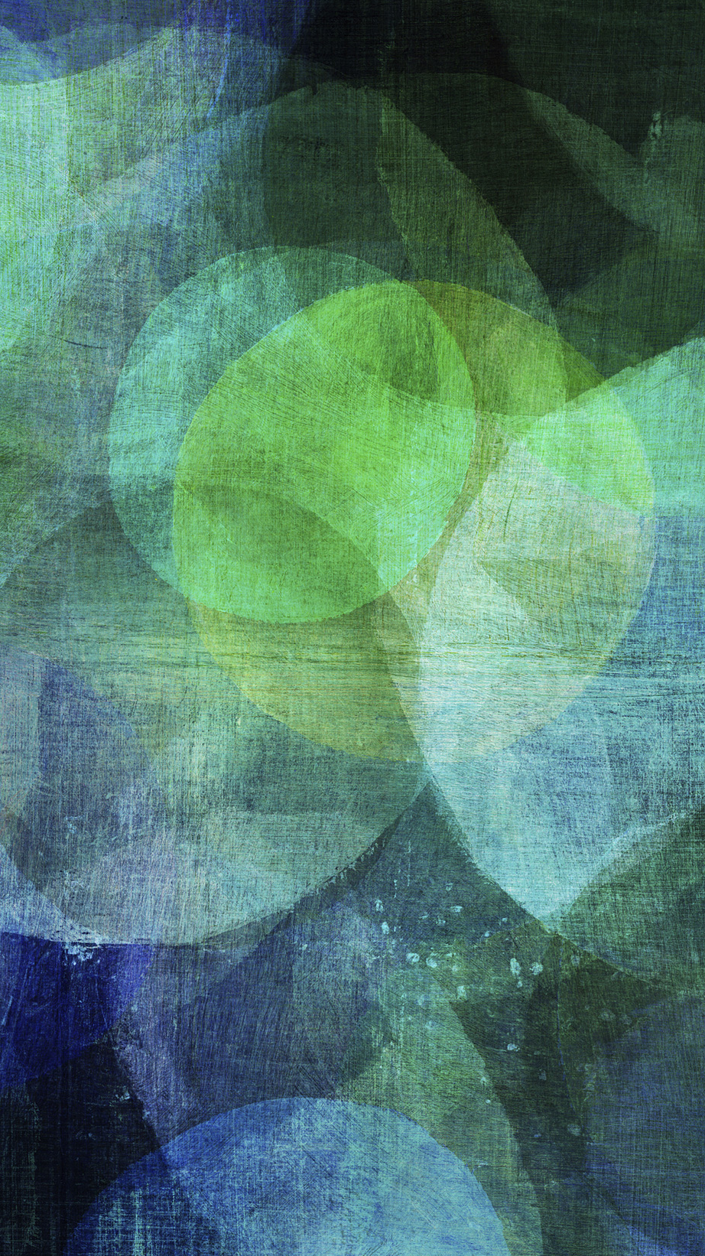
Thank you
By Anshuman Saboo
17BCE0141

